Slide 1
Snow crab population models & Life cycles

Slide 2
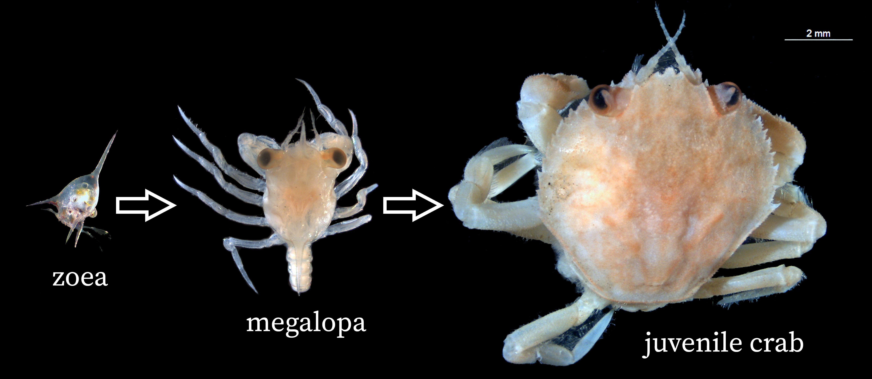
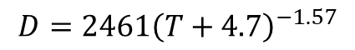
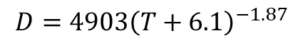
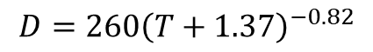
Snow crab larval stages:
Duration as a function of temperature
Larvae hatched in April or May
Zoea I
$$D=4903{\left(T+6.1\right)}^{−1.87}$$
Zoea II
$$D=2461{\left(T+4.7\right)}^{−1.57}$$
Megalopa
$$D=260{\left(T+1.37\right)}^{−0.82}$$
Instar I

Slide 3
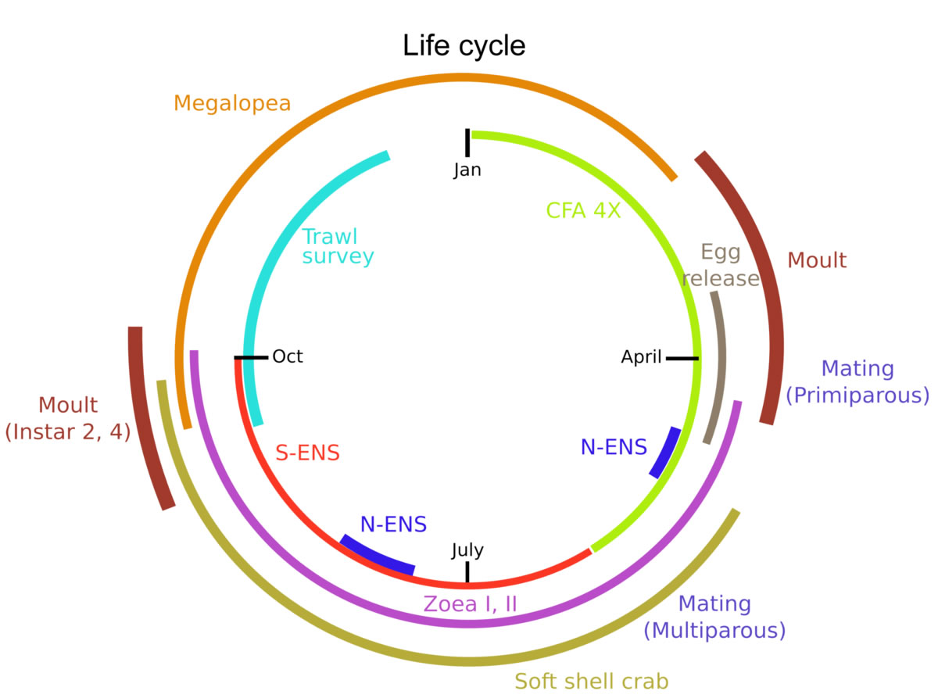
Eastern Nova Scotia snow crab life cycle timing:
Females begin to moult to maturity at an average size of approximately 55 mm CW and mate between winter/spring while the carapace is still soft. Complex behavioural patterns have been observed: the male helps the female remove her shell during her moult, protects her from other males and predators and even feeds her (indirectly). Pair formations (mating embrace where the male holds the female) have been seen to occur up to 3 weeks prior to mating. Upon larval release, males have been seen to wave the females about to help disperse the larvae. Females are selective in their mate choice and may die in the process of resisting mating attempts from unsolicited males. Males compete heavily for females and often injure themselves or the females (losing appendages) while contesting over a female. Once terminally moulted, snow crab can live up to 6 more years, under optimal conditions. This means that females can reproduce two or more times, depending upon environmental conditions. The carapace condition rapidly deteriorates in the last year of its life, a stage that is generally associated with a mossy and decalcified carapace.
https://www.dfo-mpo.gc.ca/species-especes/profiles-profils/snow-crab-crabe-neiges-atl-eng.html

Slide 4
Maturity stage model – female snow crab:
Duration
Stage | Survey catchability | Mortality
Immature | Low | Unknown
Adolescent | Near maximum | Fairly low (<10%)
Primiparous | Maximum | Fairly low (<10%)
Multiparous | Maximum | Higher (~20%)
6-7 years
Immature
No developing gonads
1 year
Adolescent
Developing gonads
1 year
Primiparous
Carrying first egg clutch
Remarks:
Recruitment of new crab to the immature category varies from year.
Females are not fished and impact of fishery is negligible.
Immatures are an aggregate of instars I to IX.
3-4 years
Multiparous
Carrying 2nd or 3rd egg clutch

Slide 5
Instar-stage model – female snow crab:
Table 1 : Female snow crab instar mean sizes and standard errors (in parentheses) by maturity stage. Measurement units are carapace widths in millimeters. Data are pooled from the snow crab surveys 1998 to 2022.
Year
Immature
1
I
Instar | Immature | Adolescent | Primiparous
IV | 10.3 (0.7) | - | -
V | 15.0 (1.0) | - | -
VI | 20.9 (1.4) | - | -
VII | 28.0 (1.9) | - | -
VIII | 36.3 (2.5) | 41.6 (2.8) | -
IX | 45.7 (3.1) | 48.8 (3.3) | 47.6 (3.2)
X | - | 56.3 (3.8) | 55.9 (3.8)
XI | - | - | 64.5 (4.4)
1
II
2
III
2
IV
Remark:
Instars I, II, III and IV are almost invisible in the survey data, due to very low catchability.
Survey catchability of instar IV < V < VI < VII.
Mortality for smaller instars (I, II, III and IV) is likely high, but is unknown.
There are branching processes only for instars VII and VIII. These proportions governing these processes varies through time.
The multiparous is a cumulative category, i.e. it accumulated the primiparous females from previous years.
2-3
V
3-4
VI
4-5
VII
Adolescent
5-6
VIII
VIII
Primiparous
Multiparous
6-7
IX
IX
IX
IX
Sporadic process (time-varying)
7-8
X
X
X
Most common process
8-9
XI
XI
Rarer process

Slide 6
Maturity stage model – male snow crab:
Immature
Ado sub-legal
Ado legal
No fishery impact
Some fishery impact
Mature new-shelled sub-legal
Mature new-shelled legal
Mature old-shelled sub-legal
Mature old-shelled legal
Major fishery impact

Slide 7
Instar-stage model – male snow crab:
Year
Immature
1
I
1
II
2
III
New-shelled refers to new mature crab, i.e. those have matured in the current year.
2
IV
Adolescent crab may skip a moult. This implies that they mature the next year.
2-3
V
3-4
VI
Old-shelled refers to older mature crab, i.e. those have matured in the previous years. This is a cumulative category.
4-5
VII
Adolescent
5-6
VIII
VIII
New-shelled
Old-shelled
IX
IX
IX
IX
The legal size limit is 95 mm carapace width, located approximately between instars X and XI.
6-7
7-8
X
X
X
8-9
XI
XI
XI
9-10
XII
XII
XII
10-11
XIII
XIII
XIII
11-12
XIV
XIV

Slide 8
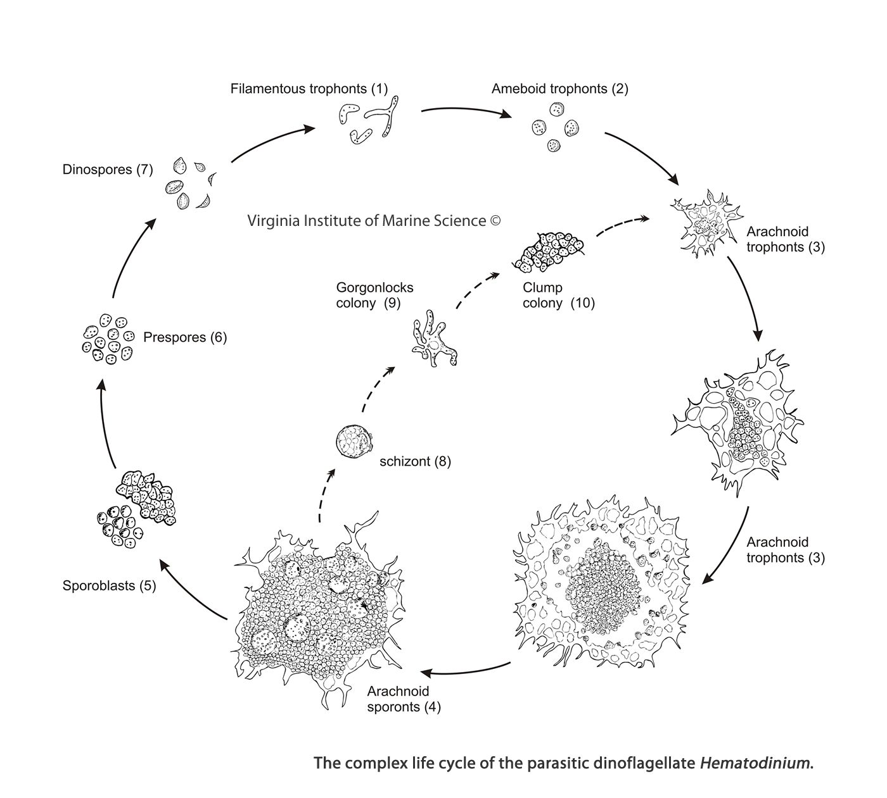
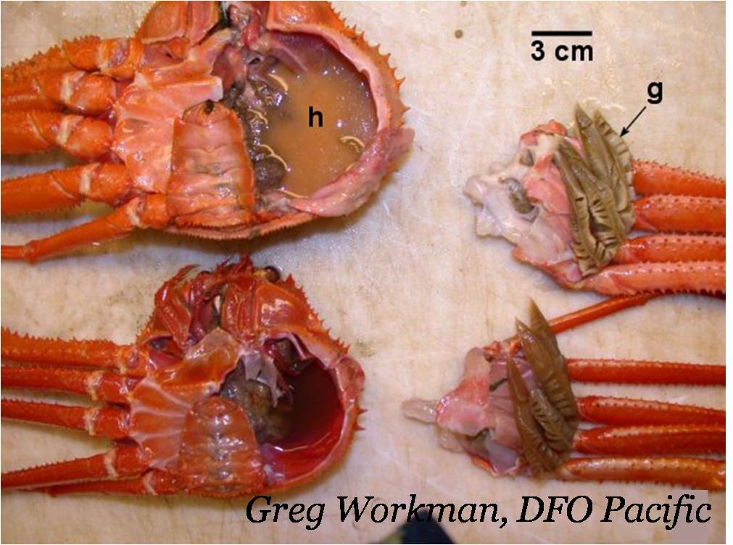
Bitter crab disease:
Jeff Shields, VIMS
“For Tanner crabs, the ones with bitter crab disease look like they've been boiled: really red, especially at their joints, and their hemolymph is milky white instead of being clear/translucent. Snow crabs also have milky white hemolymph when infected, and their color overall looks yellow/white instead of their normal light tan.”
Marilyn (Molly) Fox Zaleski
http://snowcrablove.blogspot.com/2012/12/a-sweet-victory-for-bitter-crabs.html

